Slide 1
Encountering the Mongols
AP World History Notes
Chapter 12

Slide 2
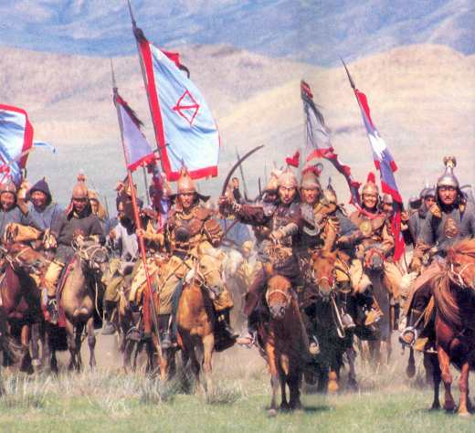
China and the Mongols
Most difficult and lengthy conquest for the Mongols
Took 70 years (1209 to 1279) to conquer
Violently conquered northern China → then controlled by various nomadic states
More peacefully conquered southern China → then controlled by the Song Dynasty
Result = unification of a divided China
Gave the Mongols legitimacy
Believed they had earned the Mandate of Heaven

Slide 3
China and the Mongols
Goal = extract wealth from China
In order to do so → must accommodate the Chinese
Accommodations included:
Use of Chinese administrative practices, taxation systems, and postal system
Took a Chinese dynastic title = the Yuan
Transferred capital from Karakorum in Mongolia to Beijing in China

Slide 4
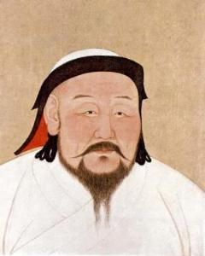
Kublai Khan
Mongol ruler of the Yuan dynasty (1271-1294)
Improved roads
Built canals
Lowered some taxes
Supported scholars and artists
Limited the death penalty and torture
Supported peasant agriculture

Slide 5
China and the Mongols
Mongol rule in China was still harsh, exploitative, foreign and resented
Mongols did NOT become Chinese and they did not accommodate EVERY aspect of Chinese culture

Slide 6
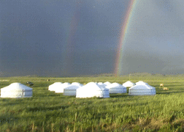
Mongols Being Mongols
Many still lived, ate, slept, and gave birth in yurts they put up everywhere
Planted steppe grass within the capital and let animals roam freely
Didn’t use civil service exams
Didn’t learn Chinese

Slide 7
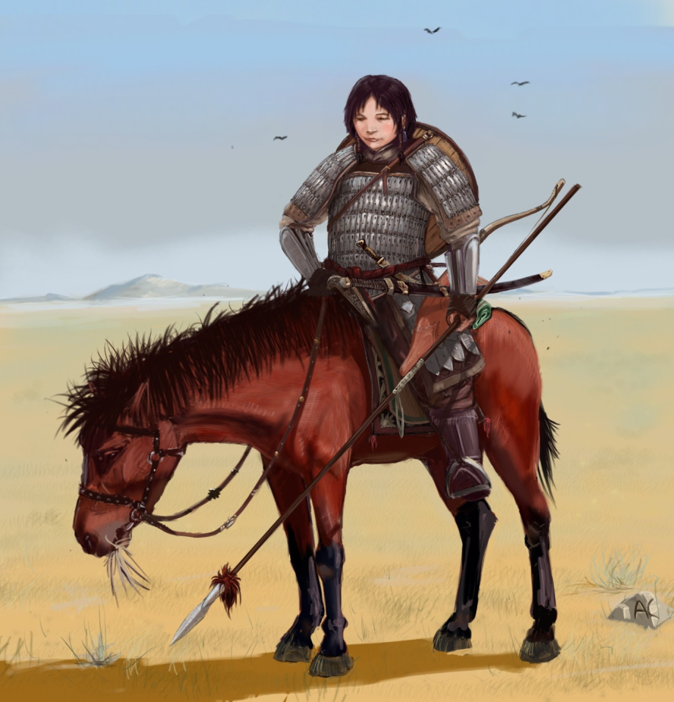
Mongols Being Mongols
Mongol women never adopted foot binding
Intermarriage = forbidden
Chinese scholars = couldn’t learn Mongol script
Supported artisans and merchants → opposite of Confucian values
Mongol women mixed freely with men, rode horseback, and hunted

Slide 8
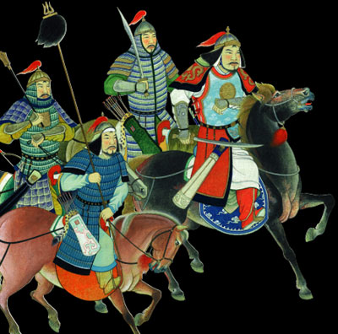
China and the Mongols
Mongol rule in China declined in the mid-1300s
Many factors caused this decline:
Division among the Mongols
Rising prices (inflation)
Epidemics of the plague
Growing peasant rebellions
1368 = all Mongols forced out of China and returned home to the steppe

Slide 9
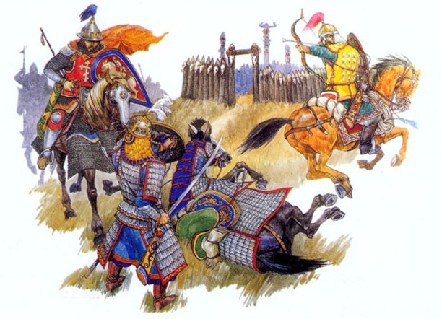
Persia and the Mongols
Conquest of Persia = much quicker and more violent than that of China
1258 = capital of Baghdad sacked
End of Abbasid dynasty
More than 200,000 people massacred

Slide 10
Devastation to Persia
Peasants pushed off their land due to heavy taxation
Nomadic Mongols with their herds of animals turned agricultural land into pasture, wasteland, and desert
Irrigation channels = neglected

Slide 11
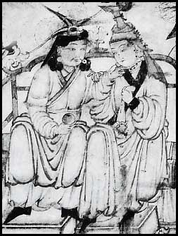
Persia and the Mongols
Many Mongols in Persia were heavily influenced by the Persians there:
Adopted Islam
Left government operation in Persian hands
Learned Persian
Some turned to farming and abandoned nomadic ways
Some married local people
Mongol man and Persian woman

Slide 12
Russia and the Mongos
https://www.powtoon.com/c/goazFavKwG2/0/m

Slide 13
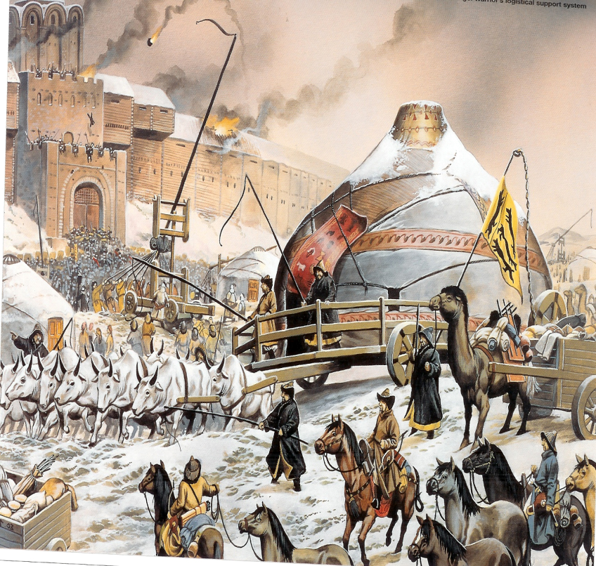
Russia and the Mongols
Heavy devastation to Russia → perhaps more than in Persia
Mongol conquest of Russia = called the “Khanate of the Golden Horde”
Mongols defeated the Russians, but did NOT occupy Russia
Russia had little to offer
Less developed economy
Not located along any major trade routes
Painting of the fall of Kievan Rus

Slide 14
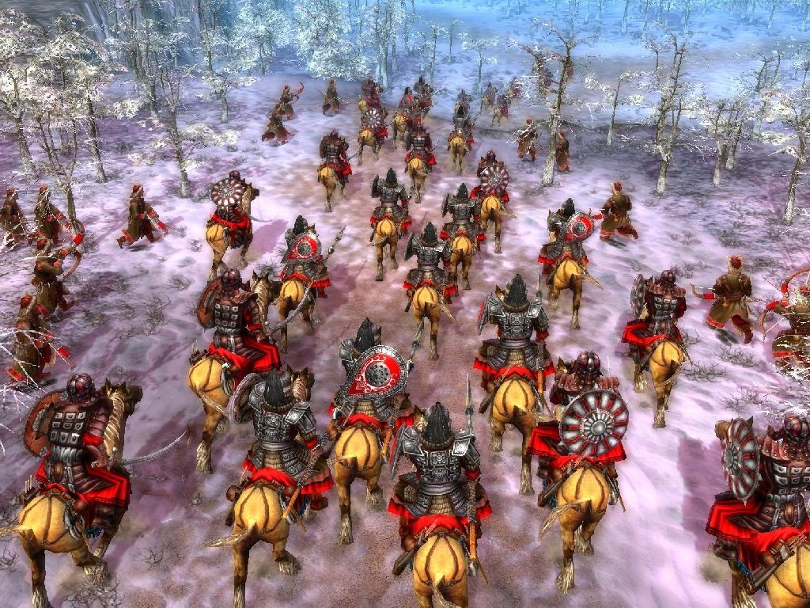
Exploitation of the Russians
Russian princes required to send tribute to the Mongols
Variety of heavy taxes on Russian people
Continuing border raids
Tens of thousands of Russians sent into slavery

Slide 15
Influence on the Russians
Although the Mongols weren’t influenced much by the Russians, the Russians were influenced by the Mongols:
Adopted Mongols’ weapons, court practices, diplomatic rituals, taxation system, and military draft

Slide 16
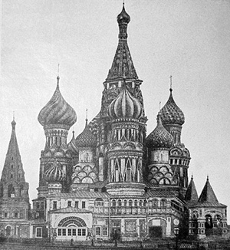
End of Mongol Rule in Russia
Mongol rule in Russia started to decline by the end of the 1400s
Major causes of this decline:
Divisions among Mongols
Growing strength of Russian state → now centered on the city of Moscow

